Slide 1
Population Genetics Analysis of Vervets

Slide 2
Data: Reference
From VRC
Sequenced by 454 at 8X (and more) and Illumina 100bp PE at ~10X.
Current assembly is based on 454 reads.
~480K contigs in total. Size from 2bp to 13.4Mb.
~7K (size>=2Kbp) used in alignment.
Variants called over top 156 contigs (~1Gb in total size)
Notes:
7K out of 480K contigs are of total size 2.8Gb. All of them, but not the top 156 contigs, are used in alignment phase to minimize mis-aligned reads (reads that are not mapped to their source on the genome).

Slide 3
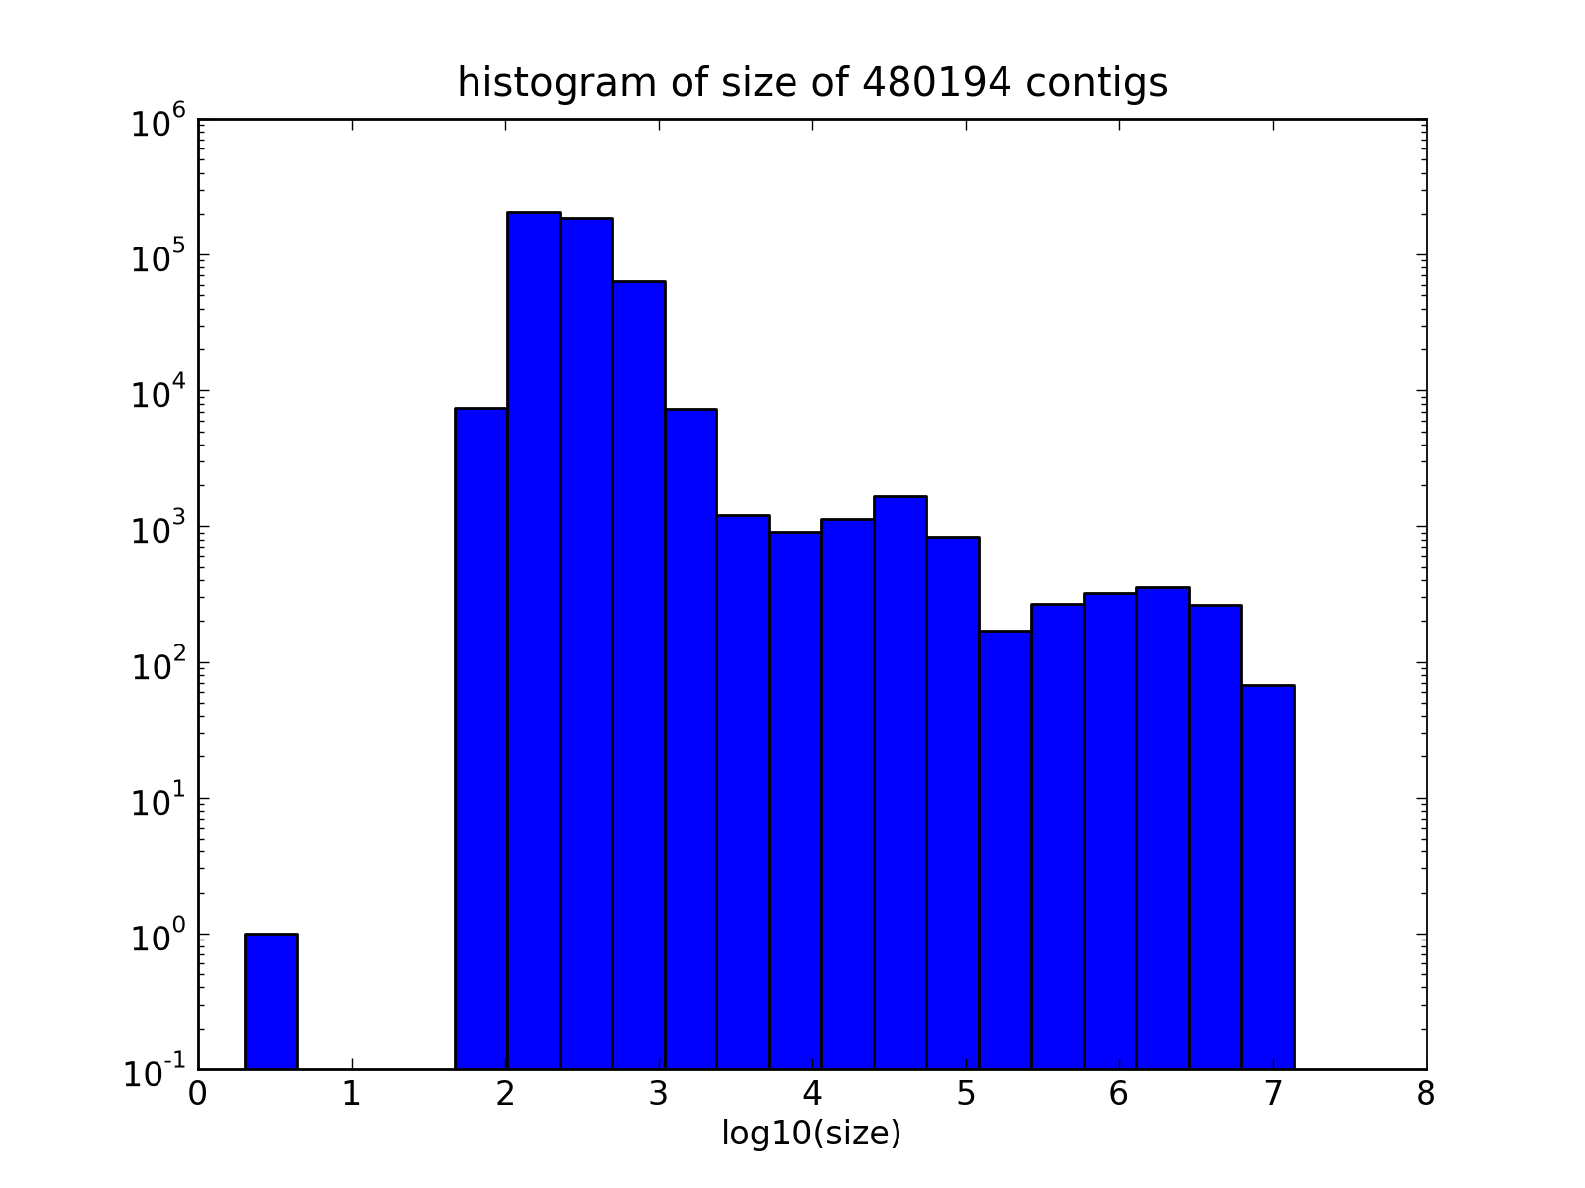
Size histogram of ~480K Supercontigs
Notes:
X-axis is in log scale.

Slide 4
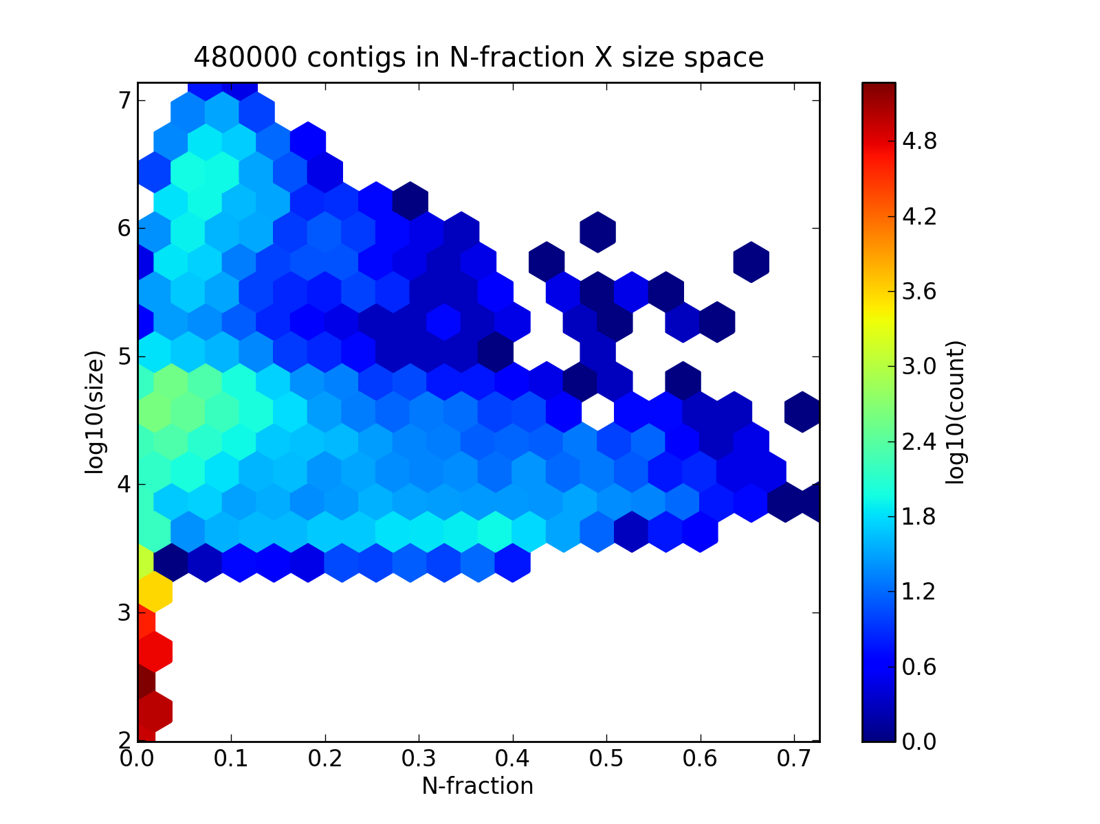
Median-sized contigs (10kb-100kb) have lots of missing bases.
Notes:
X-axis the fraction of missing calls (“N”) in one contig. Y-axis is the log10(Contig-size). Each hexagon represents a set of contigs whose missing fraction and log10(size) fall into the hexagon space. Each hexagon is colored according to the number of contigs it contains. This type of plot is usually called a 2D histogram.

Slide 5
Data: Population Sequencing
116 out of ~1000 VRC monkeys
Most are sequenced by Solexa PE at 4-5X.
Four are sequenced at 30-40X.
Due to concern about the HWE violation, 15 most distant ones (>=4 meiotic distance) are selected into an additional set in variant calling and frequency comparison.
5 St. Kitts + 5 Nevis
1 Barbados
5 African subspecies
Notes:
HWE violation directly affects the variant caller because HWE is one of the assumptions of samtools.

Slide 6
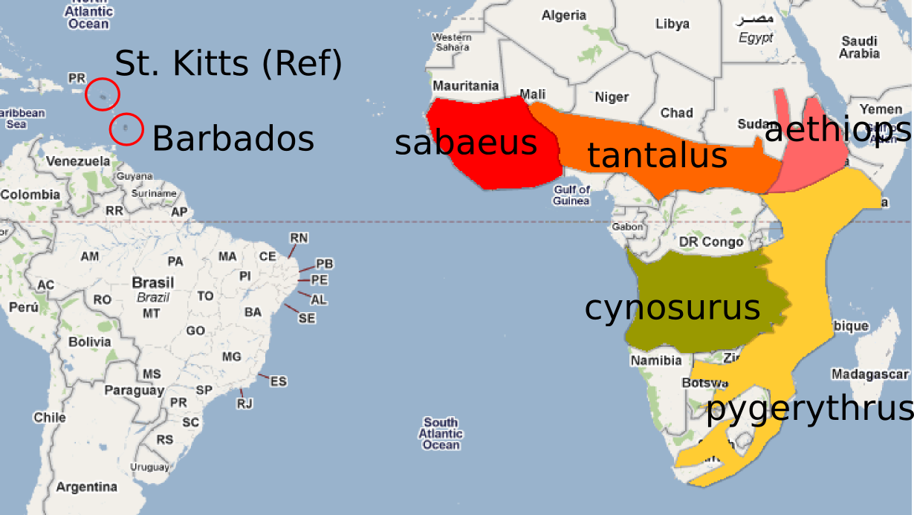
Geographic Map

Slide 7
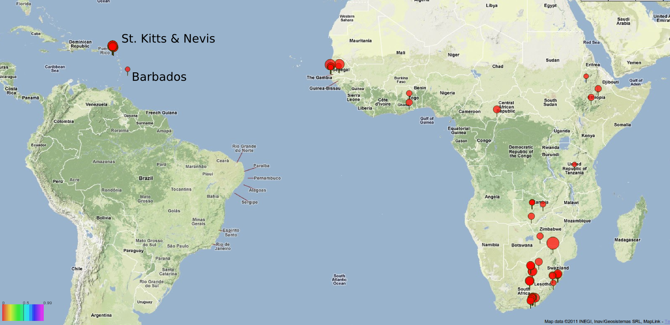
Vervet World Wide Collection

Slide 8
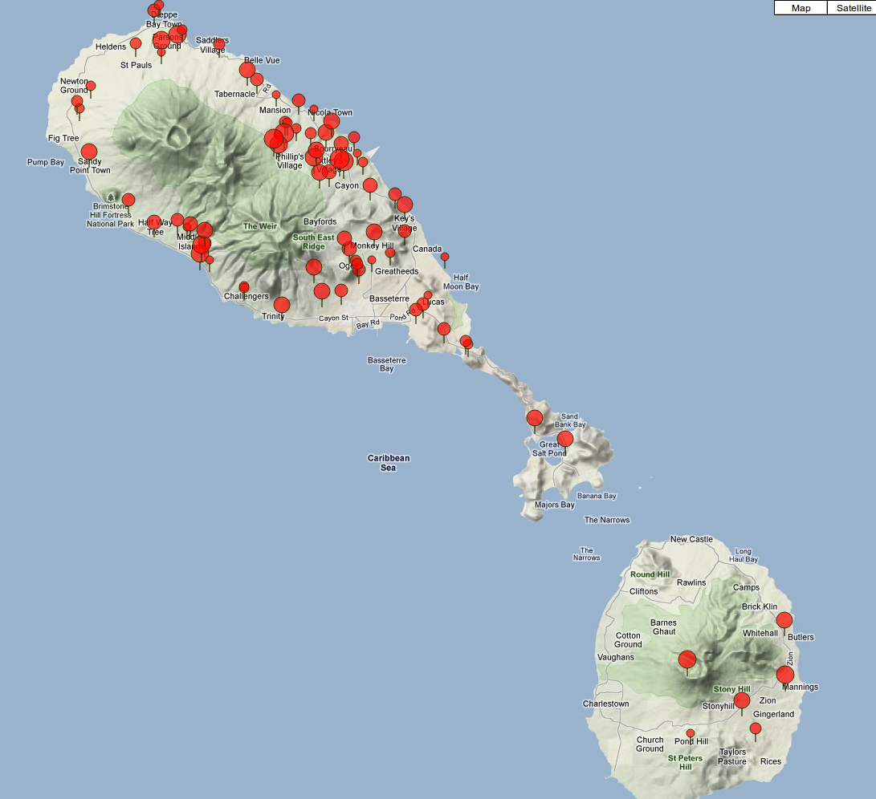
Collection at St. Kitts & Nevis

Slide 9
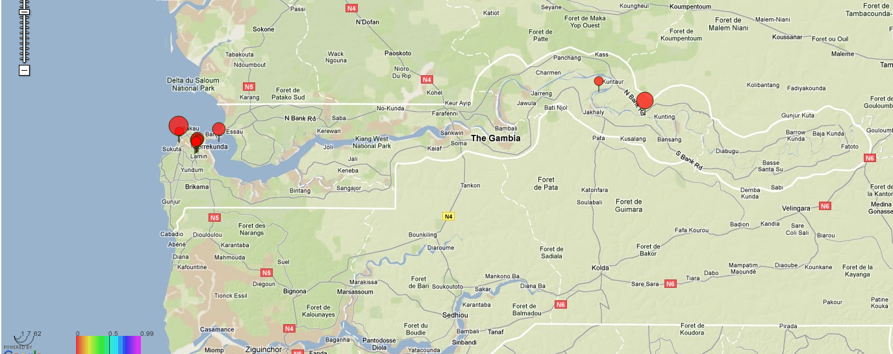
Collection at Gambia

Slide 10
Outline
Vervet-Human and Vervet-Macaque Synteny
SNP variant pipeline and QC through trios
Relationship of Carribean monkeys to African subspecies
St. Kitts v.s. Nevis
VRC v.s. St. Kitts & Nevis
Conclusions
Outlook
Notes:
Here's an outline of what will be presented in this slide-show. Relate outline to questions.
Vervet closer o macaque or human based on synteny?
Relationship between Barbados and the reference(St. Kitts)?
Which African subspecies is the most likely source of Carribean monkeys?
What's the relationship among African subspecies?
How is VRC diversity compared to St. Ktts/Nevis?

Slide 11
Synteny
Top 156 contigs from vervet reference.
Hg19 for human reference.
Latest Macaque genome.
Run mummer http://mummer.sourceforge.net/.

Slide 12
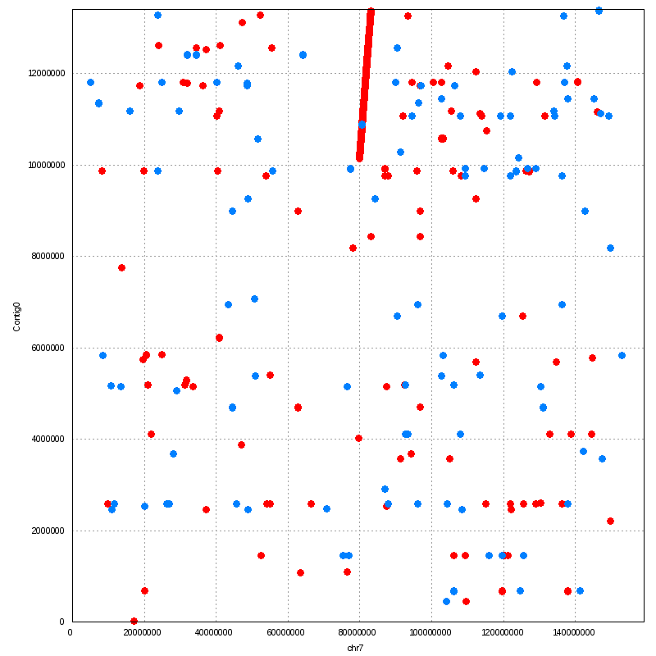
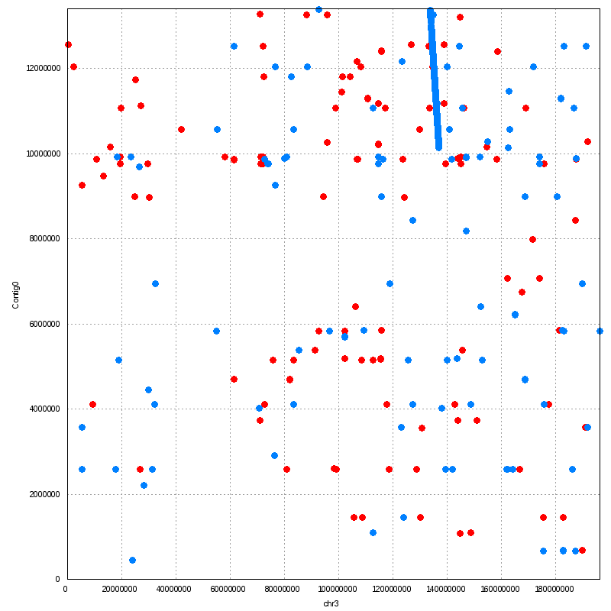
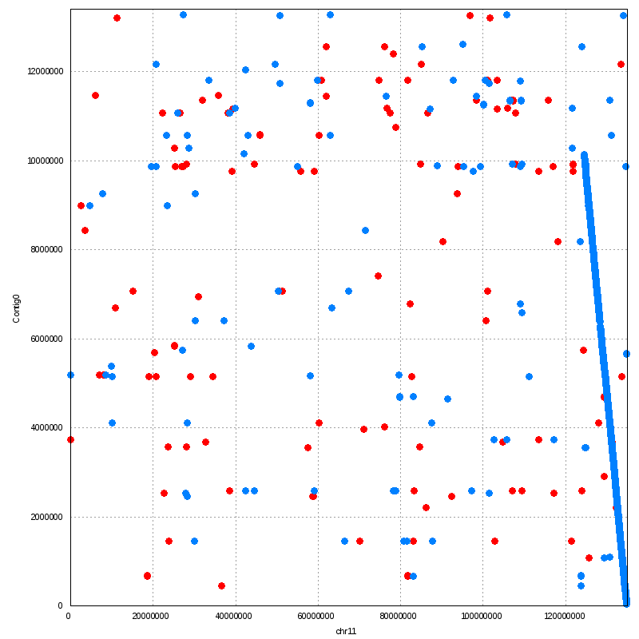
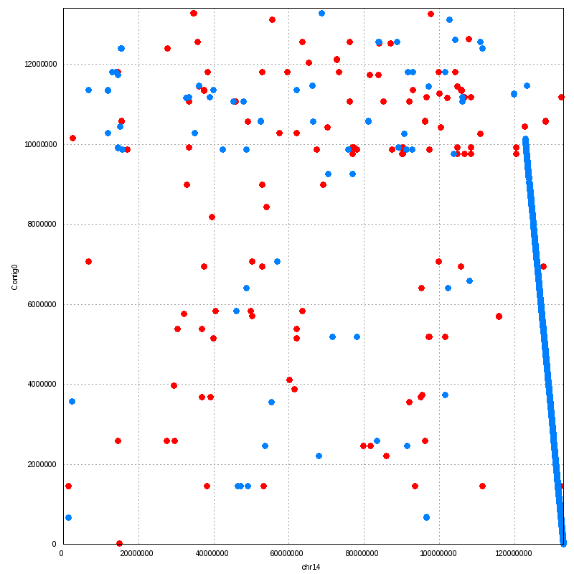
A translocaton happens in MRCA of human & macaque?
Supporting human & macaque closer.
Contig0
human chr7/chr11 macaque chr3/chr14

Slide 13
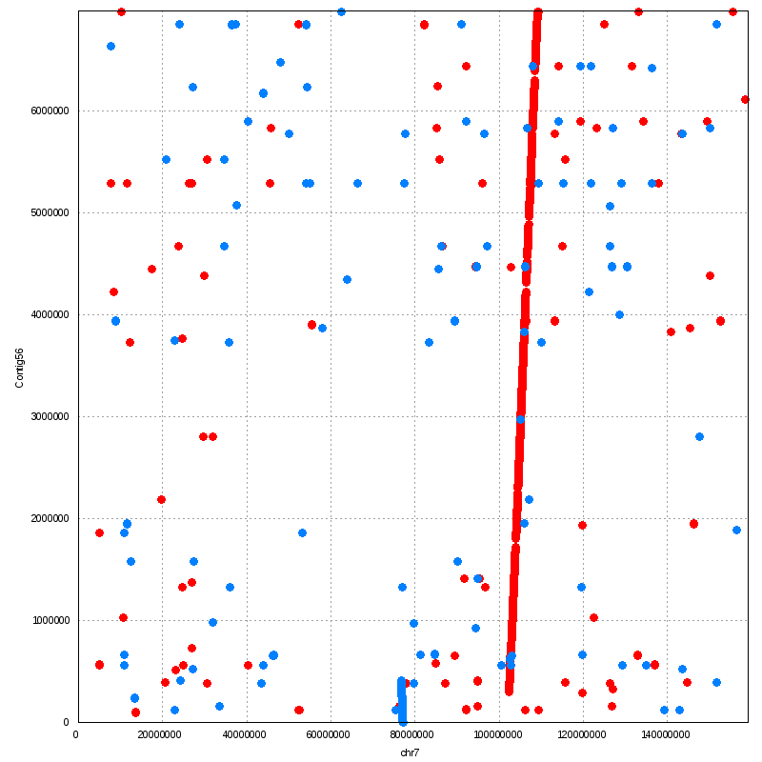
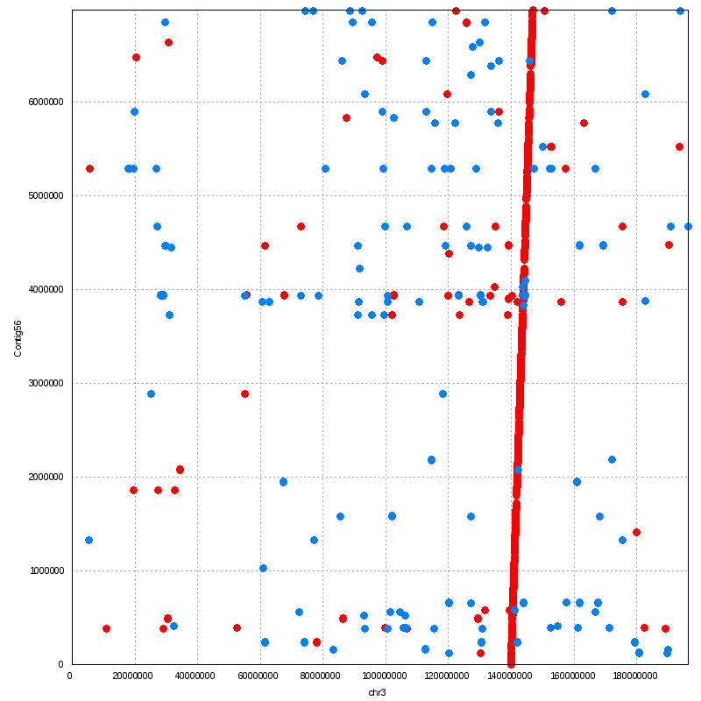
A translocation in human, aided by a duplication. Supporting macaque & vervet closer.
Contig56
human chr7 macaque chr3

Slide 14
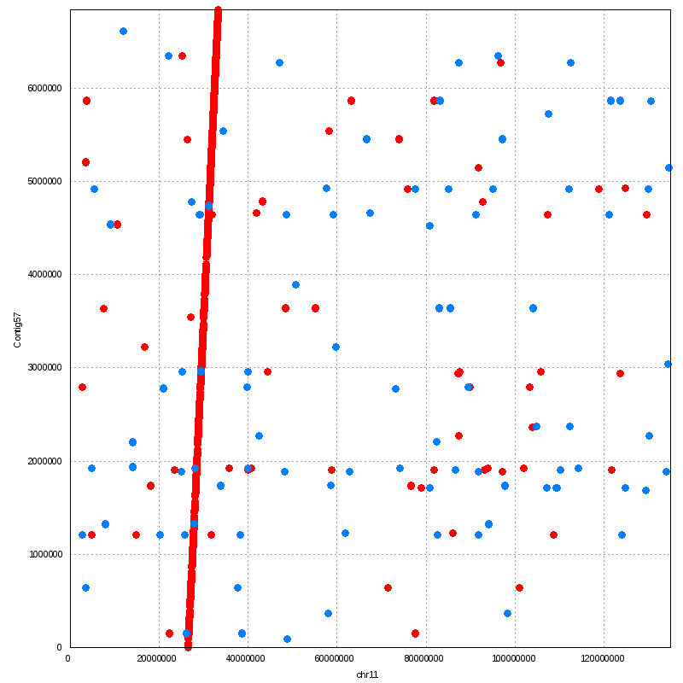
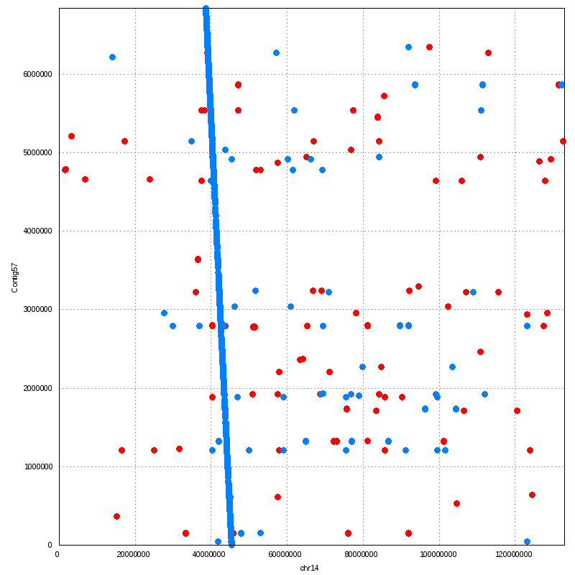
No large-scale structural event.
Contig57
human chr11 macaque chr14

Slide 15
Support for Different Trees by Synteny Eyeballing based on top 11 contigs (11 because 156 is too many for eyeballing.)
But alignment to macaque genome shows fewer mismatches than to human reference.
About that 0.5, next slide.

Slide 16
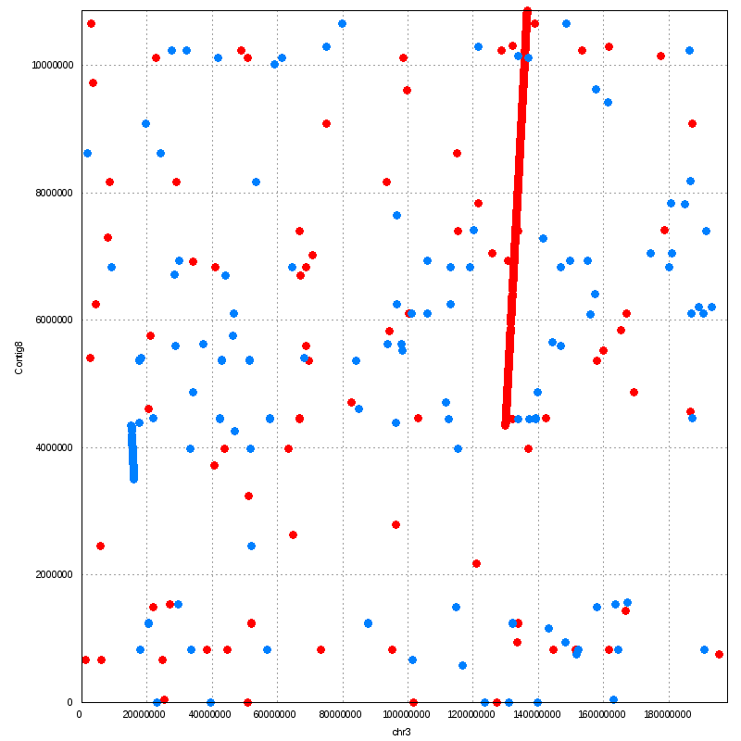
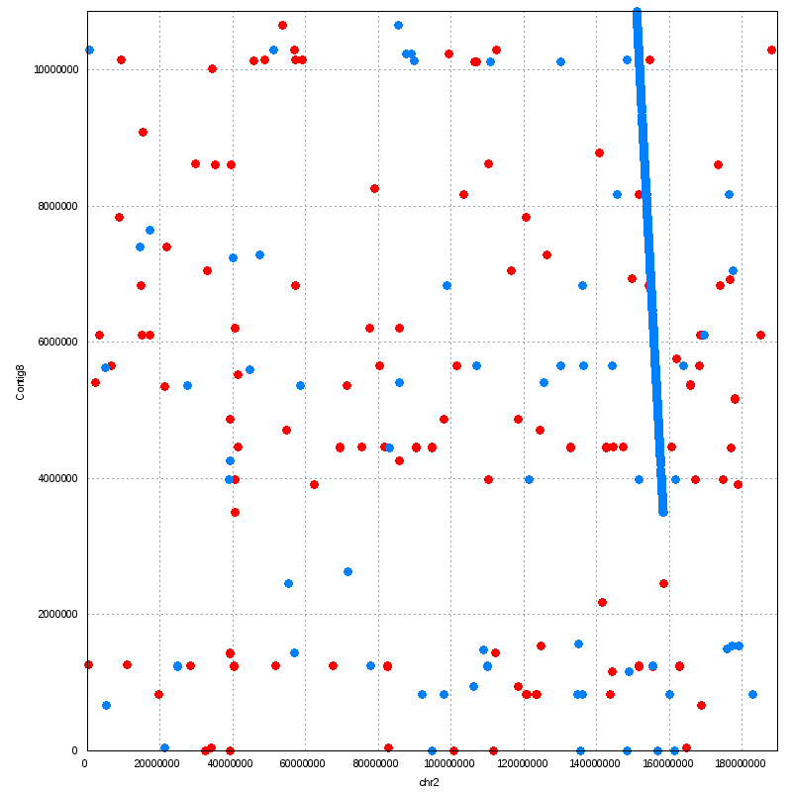
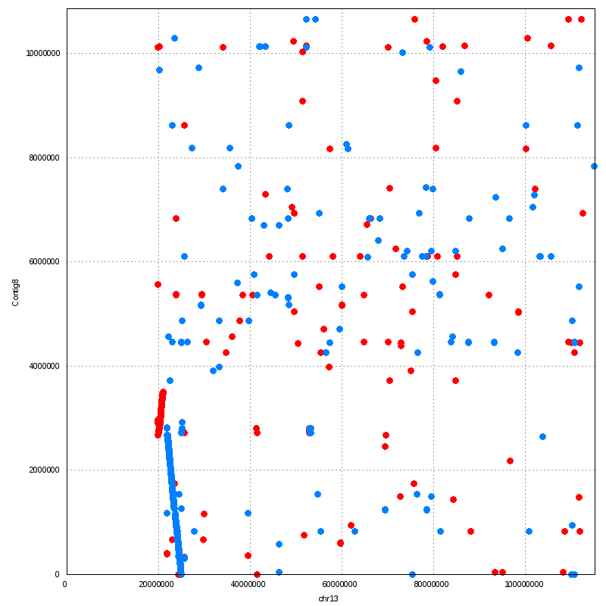
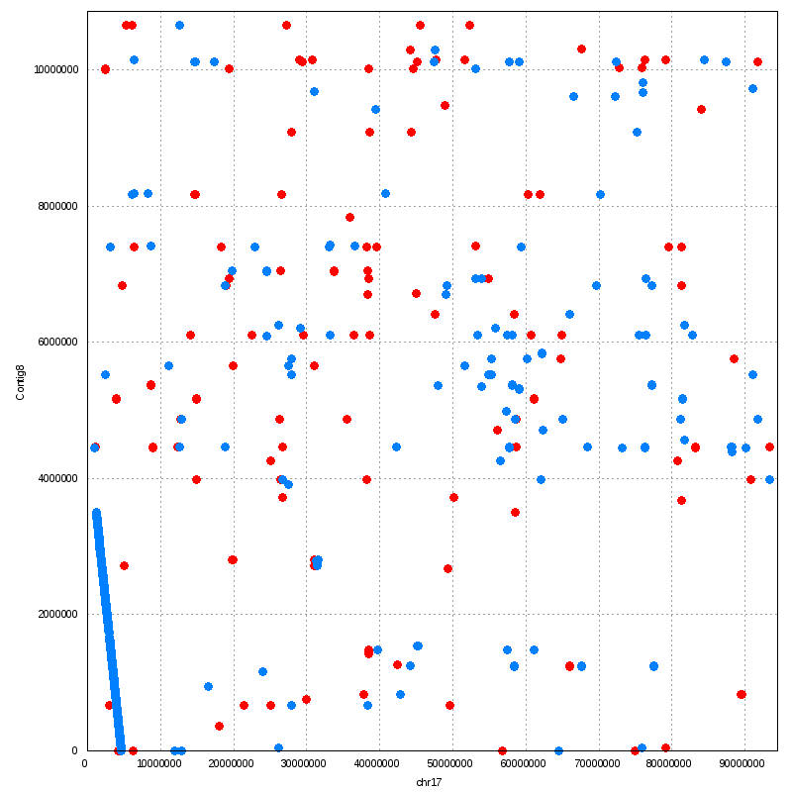
1st. One translocation happens in MRCA of human & macaue. Then, one translocation + two inversions happen in human.
Contig8
human chr3/chr13 macaque chr2/chr17

Slide 17
SNP Pipeline
Use top 7559 contigs (size>=2kb) as reference.
Run alignment for every individual's reads independently.
Select a population of individuals (i.e. St. Kitts).
Run GATK & samtools on alignments from the whole population (2MB interval by interval).
Take the intersection of GATK & samtools calls.

Slide 18
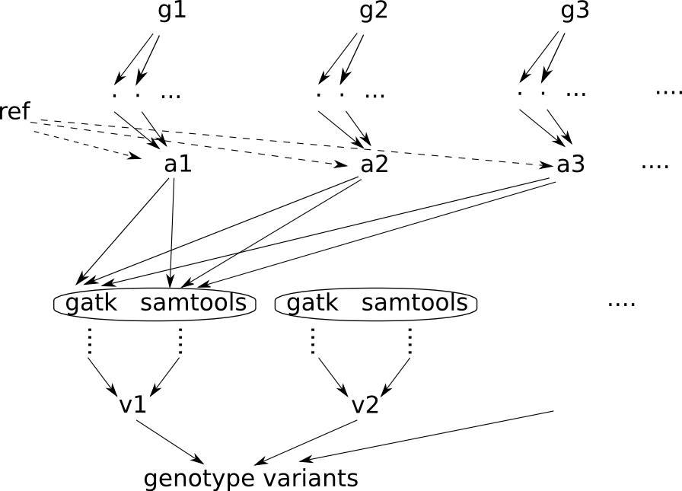
Diagram for one population.
Notes:
Note:
1. variant caller is run on alignments from a population, not each individual separately. => boost the variant-discovery power at low-coverage regions.

Slide 19
SNP QC based on trio inconsistency
4 trios out of 116 VRC sequenced. Two trios have the same parents. => 10 monkeys in total.
For each locus, if the child's genotype is not one of the 4 combinations of two parents' genotype, this locus is flagged as inconsistent.
Inconsistent rate = (number of inconsistencies)/(number of total variants in that contig)

Slide 20
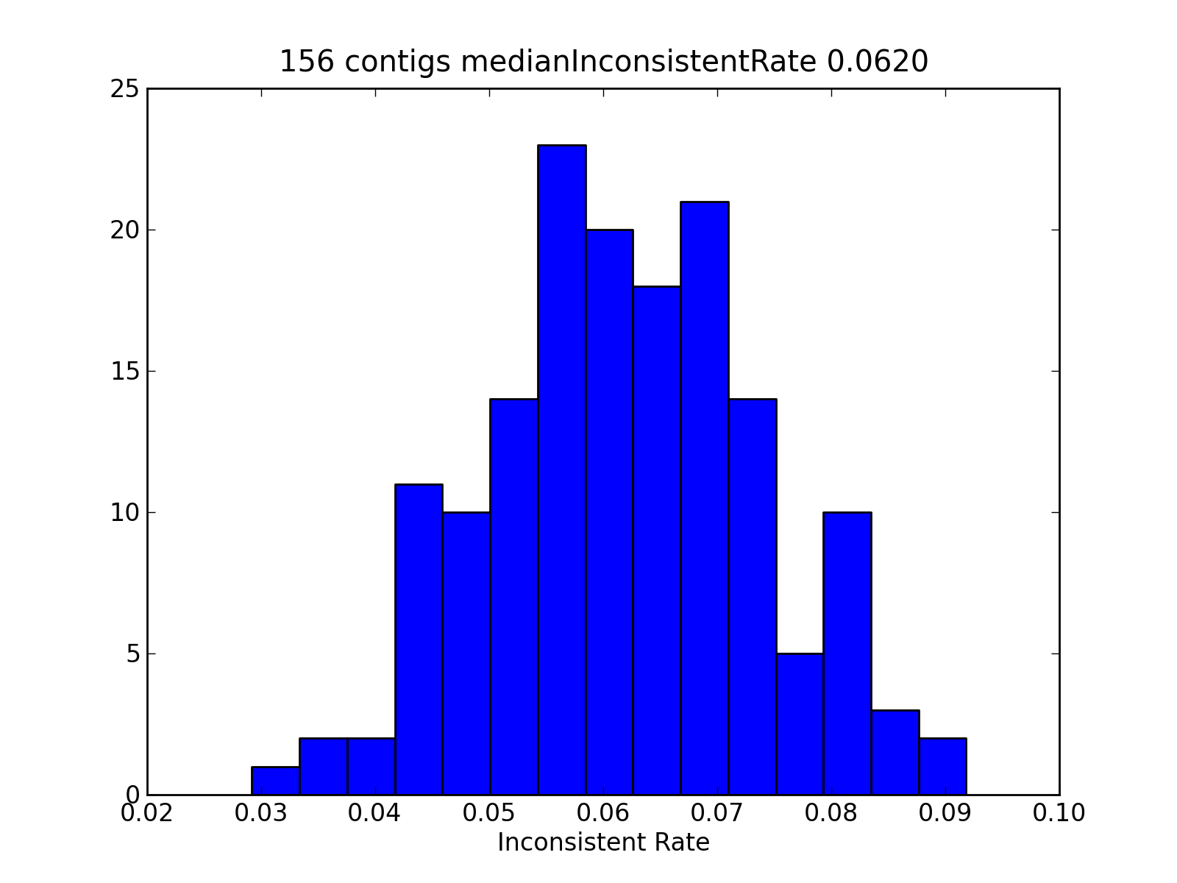
Histogram of inconsistent rate for one trio.
Note: Data includes the heterozygous calls.
(For reference, the 1000-genome project gets ~5%-30% error rate in heterozygous calls depending on allele frequency.)

Slide 21
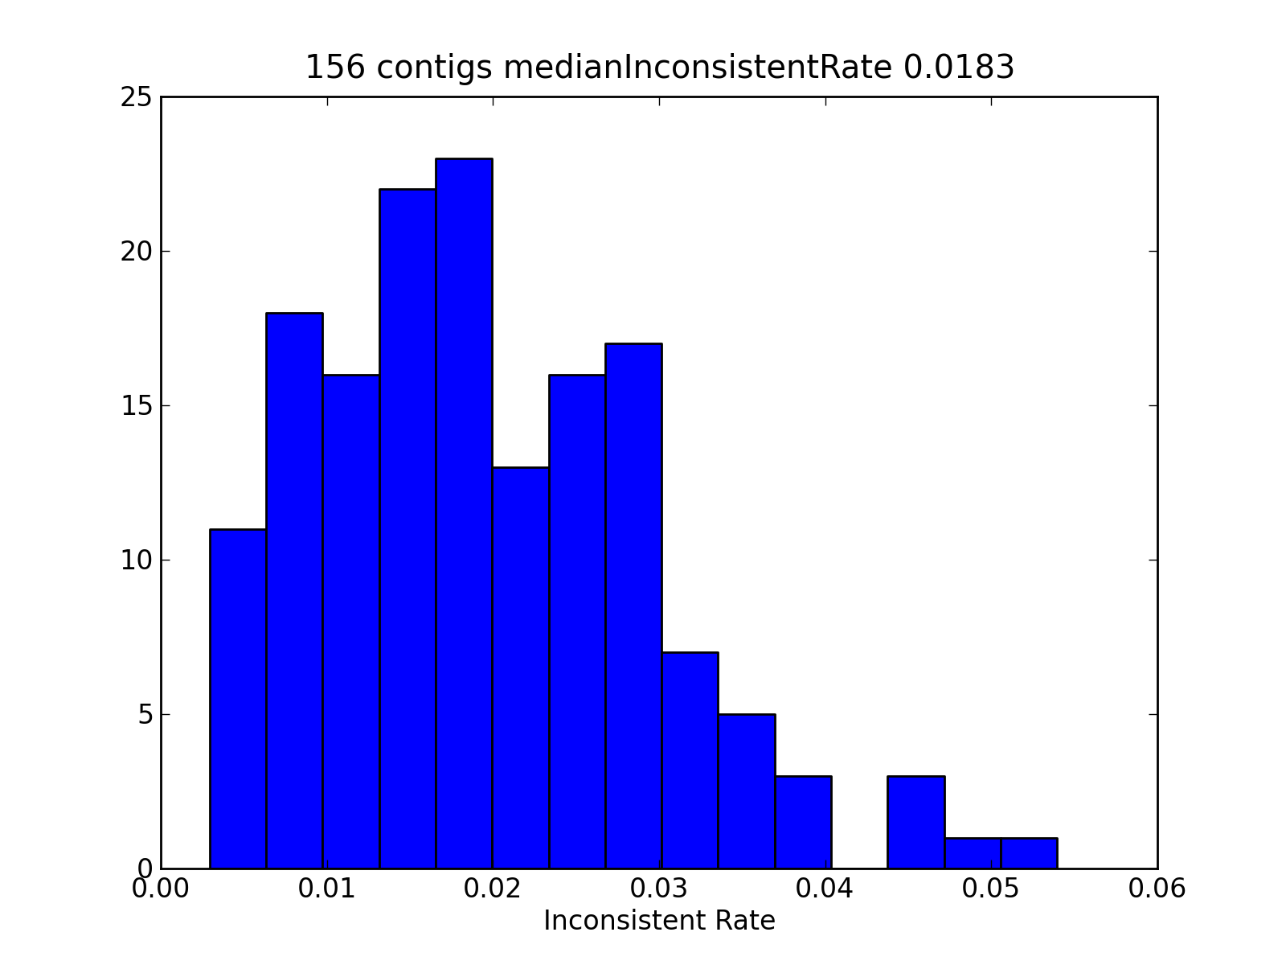
If we only focus on homozygous calls

Slide 22
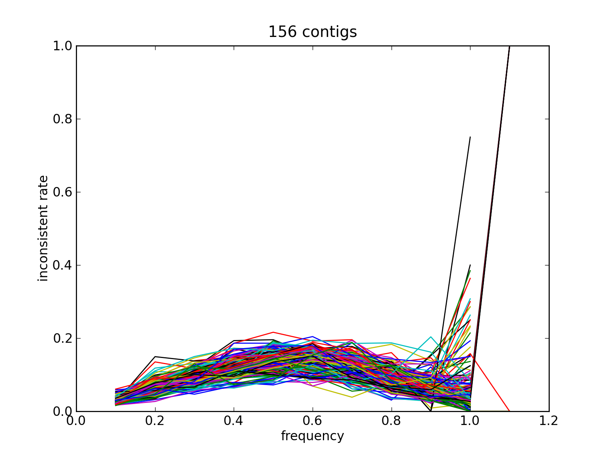
Inconsistent rate depends on the AAF (Alternative Allele Frequency)
The sudden increase in the variation of inconsistent rate near 1.0 is due to insufficient number of sites.
The point beyond 1.0 is due to float precision issue (i.e. 1.00001 is regarded as above 1.0).

Slide 23
Variant Density in different populations

Slide 24
Relationship of Carribean monkeys to African subspecies
Modify the genotype caller to output all sites (both polymorphic and non-polymorphic).
All heterozygous sites are masked as missing.
For any pair of two individuals, calculate the distance = (number of sites with different calls)/(number of total non-NA sites).
The distance could also be calculated between the reference and an individual.

Slide 25
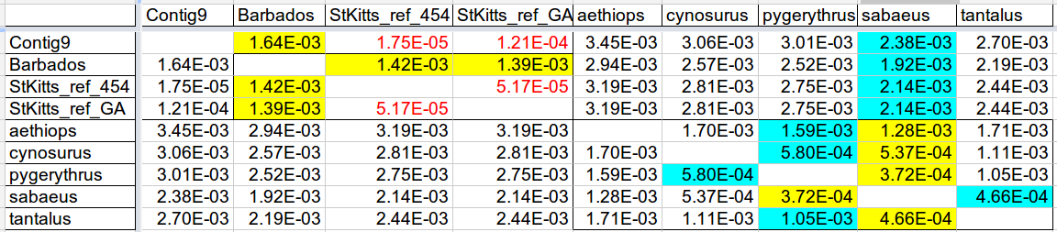
One example: Contig 9
Red: error rate.
Yellow: closest pair.
Cyan: 2nd-closest pair.

Slide 26
Draw the distance-vector to reference
Draw vectors from all contigs in one plot.

Slide 27
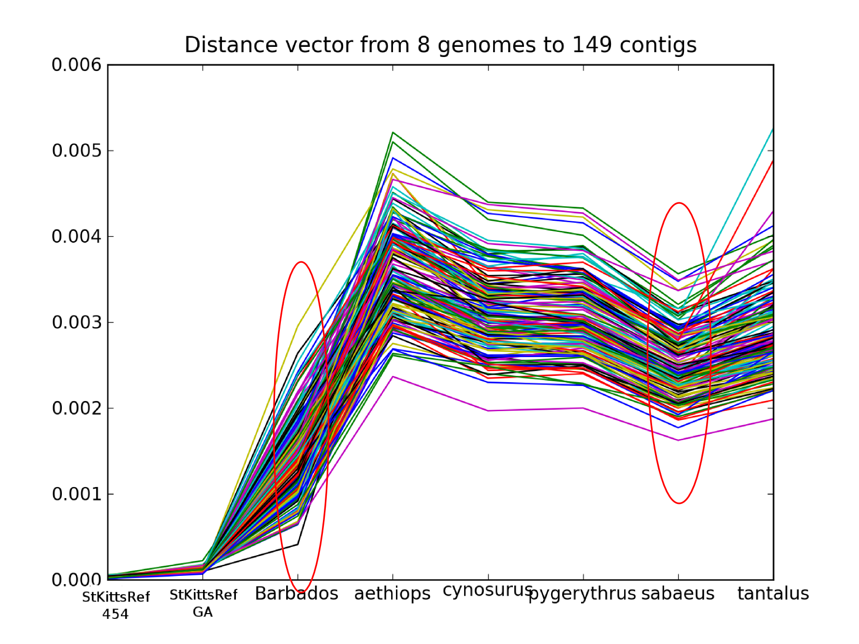

Slide 28
Relationship of Carribean monkeys to African subspecies
Barbados is much closer to the St. Kitts reference than other African subspecies.
Sabaeus is consistently the closest African subspecies to St. Kitts reference.
What is causing that big variation among different contigs?
Why the order based on distance to ref is changed in some contigs?

Slide 29
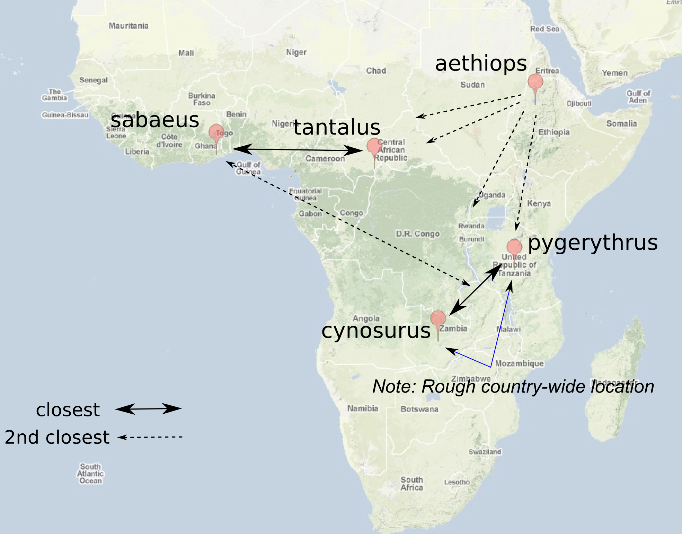
Relationship among the African subspecies

Slide 30
Relationship among the African subspecies
For pygerythrus, sabaeus has consistently been its closest subspecies.
However, cynosurus is geographically its closest, at least based on the current rough location.

Slide 31
St. Kitts v.s. Nevis
5 St. Kitts and 5 Nevis wild monkeys have been sequenced.
We are wondering how close they are to each other. Is there still genetic exchanges between them?
We ran the variant-calling pipeline on the two populations separately and compare the AAF (Alternative Allele Frequency).

Slide 32
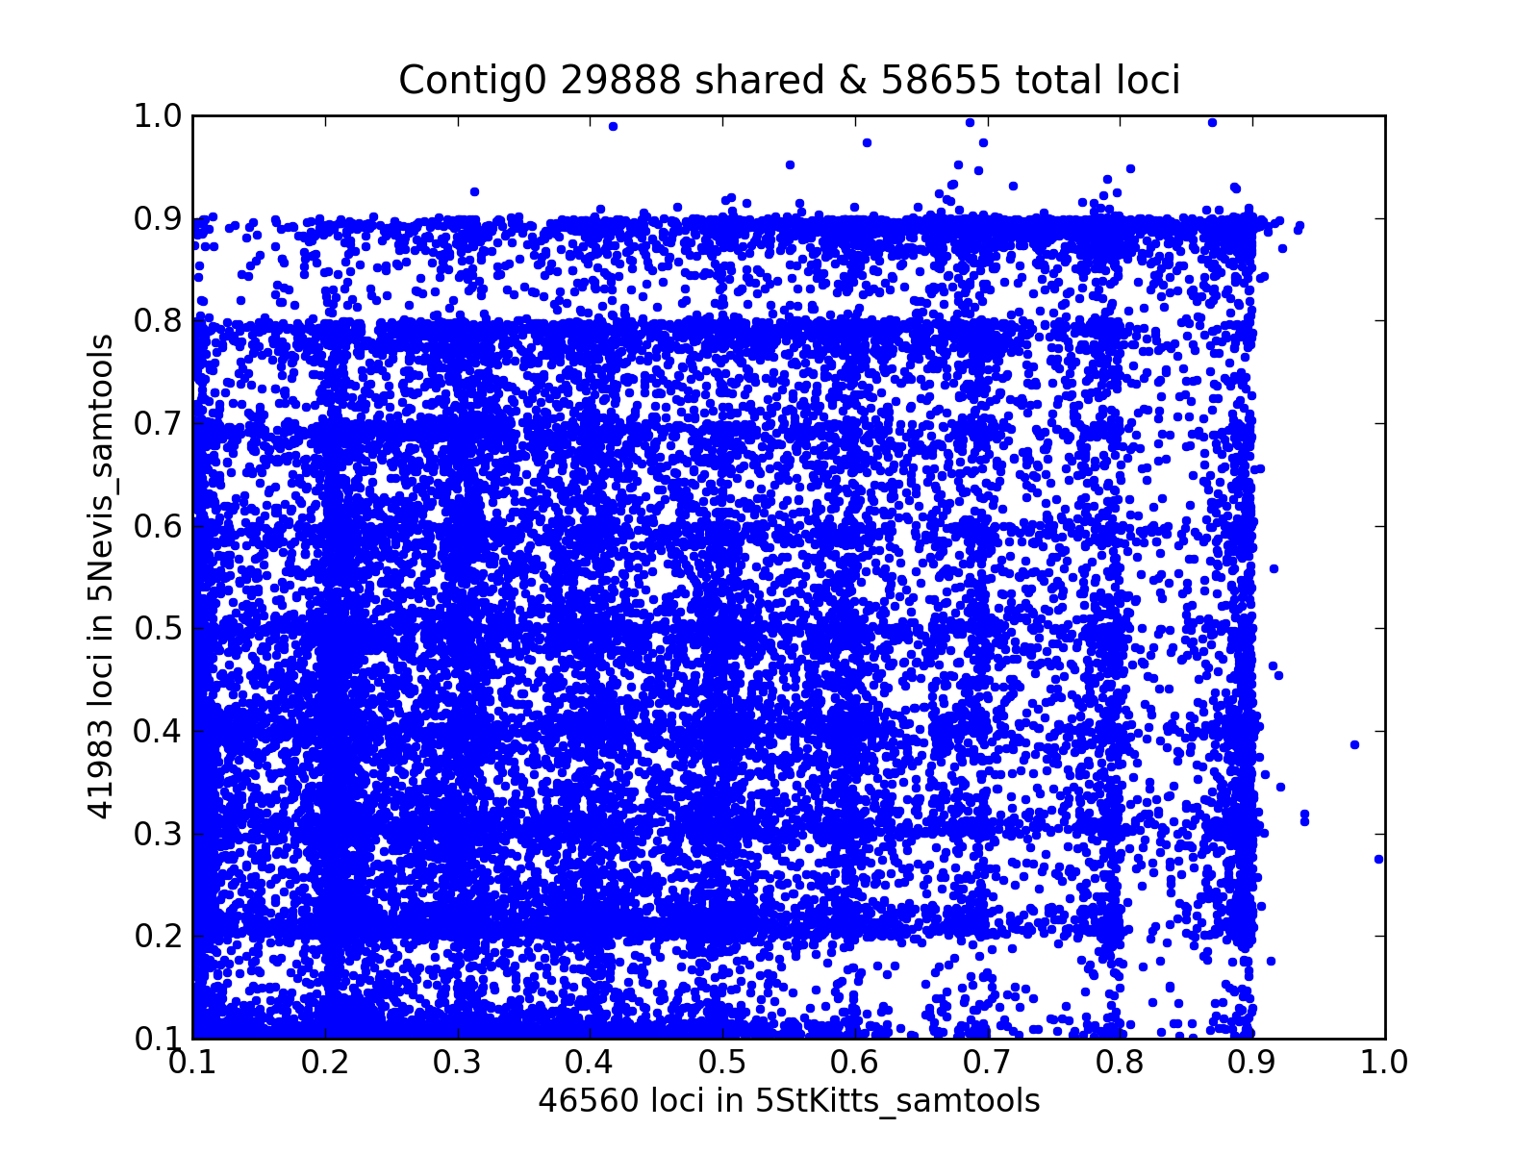
Most contigs look like this:
Each dot is a SNP locus. Plotted are the 29,888 shared polymorphic variants.
16,672 (~35.8%) St. Kitts variants are not polymorphic in 5 Nevis monkeys.
The number for the Nevis variants is 12,095 (28.8%).

Slide 33
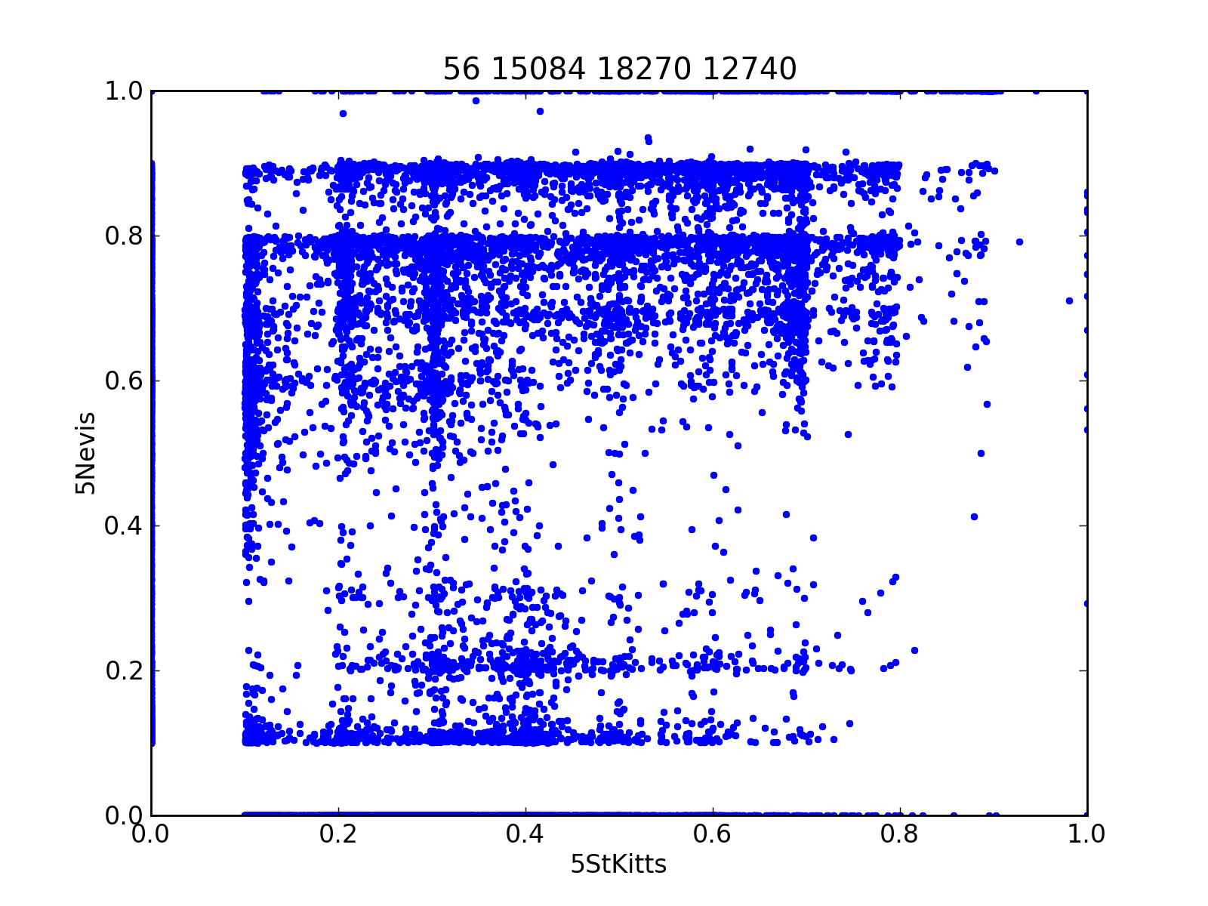
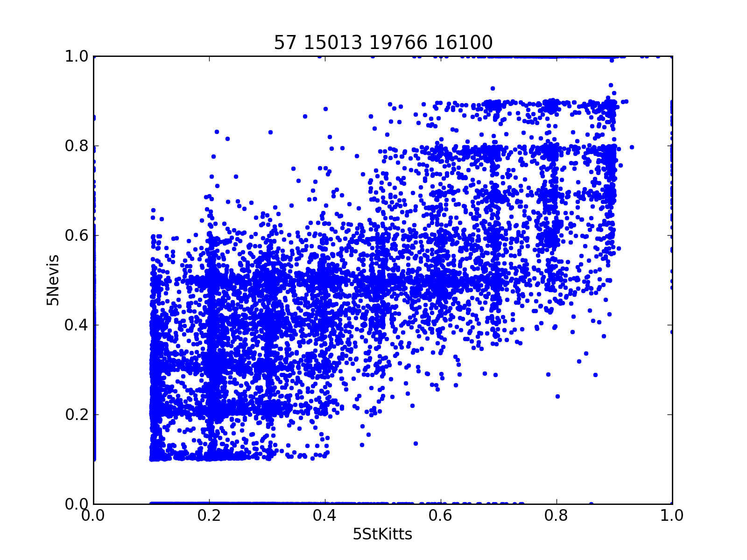
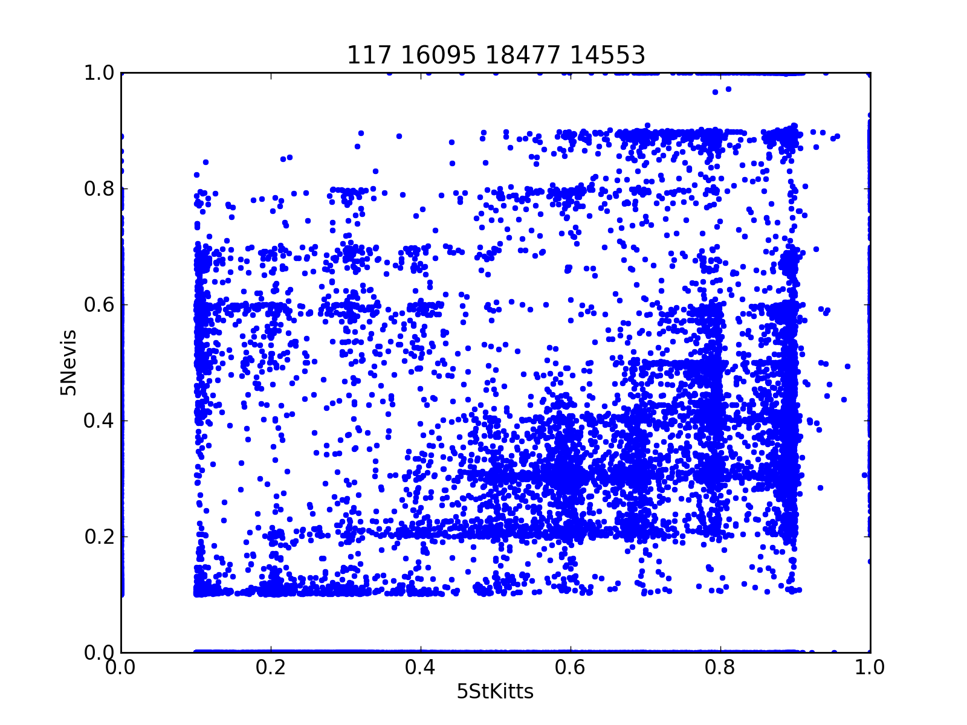
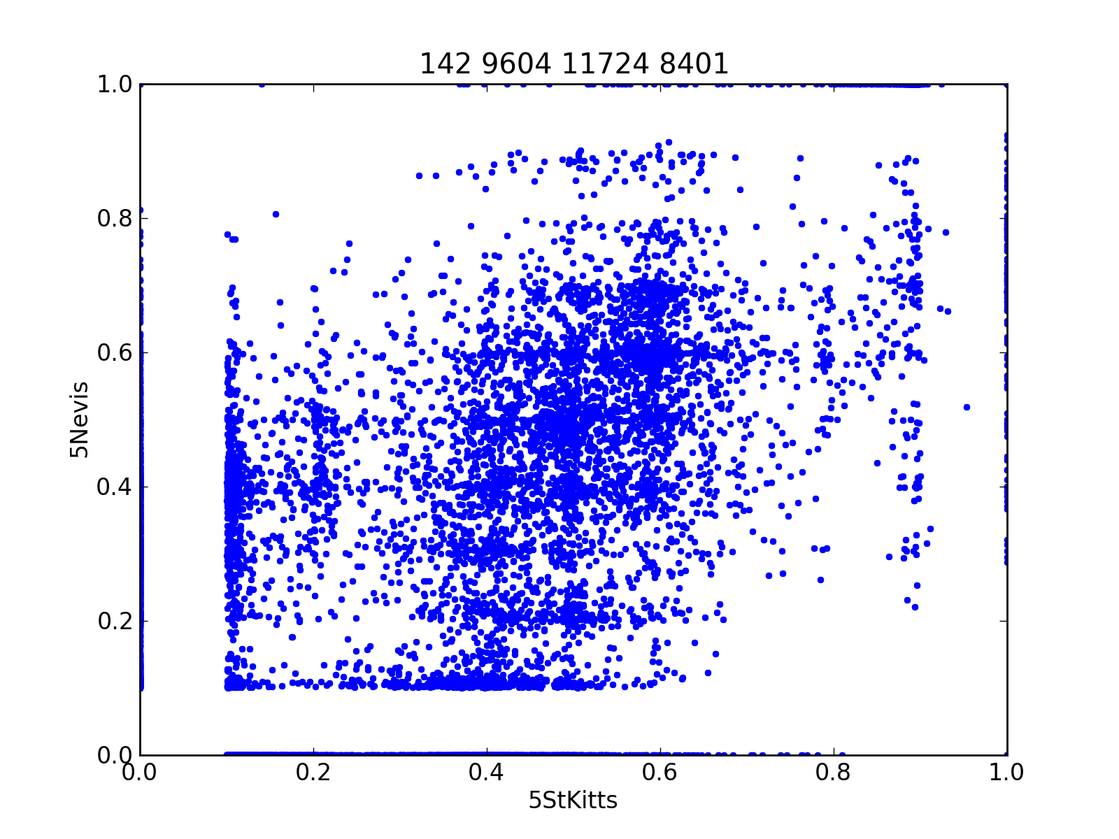
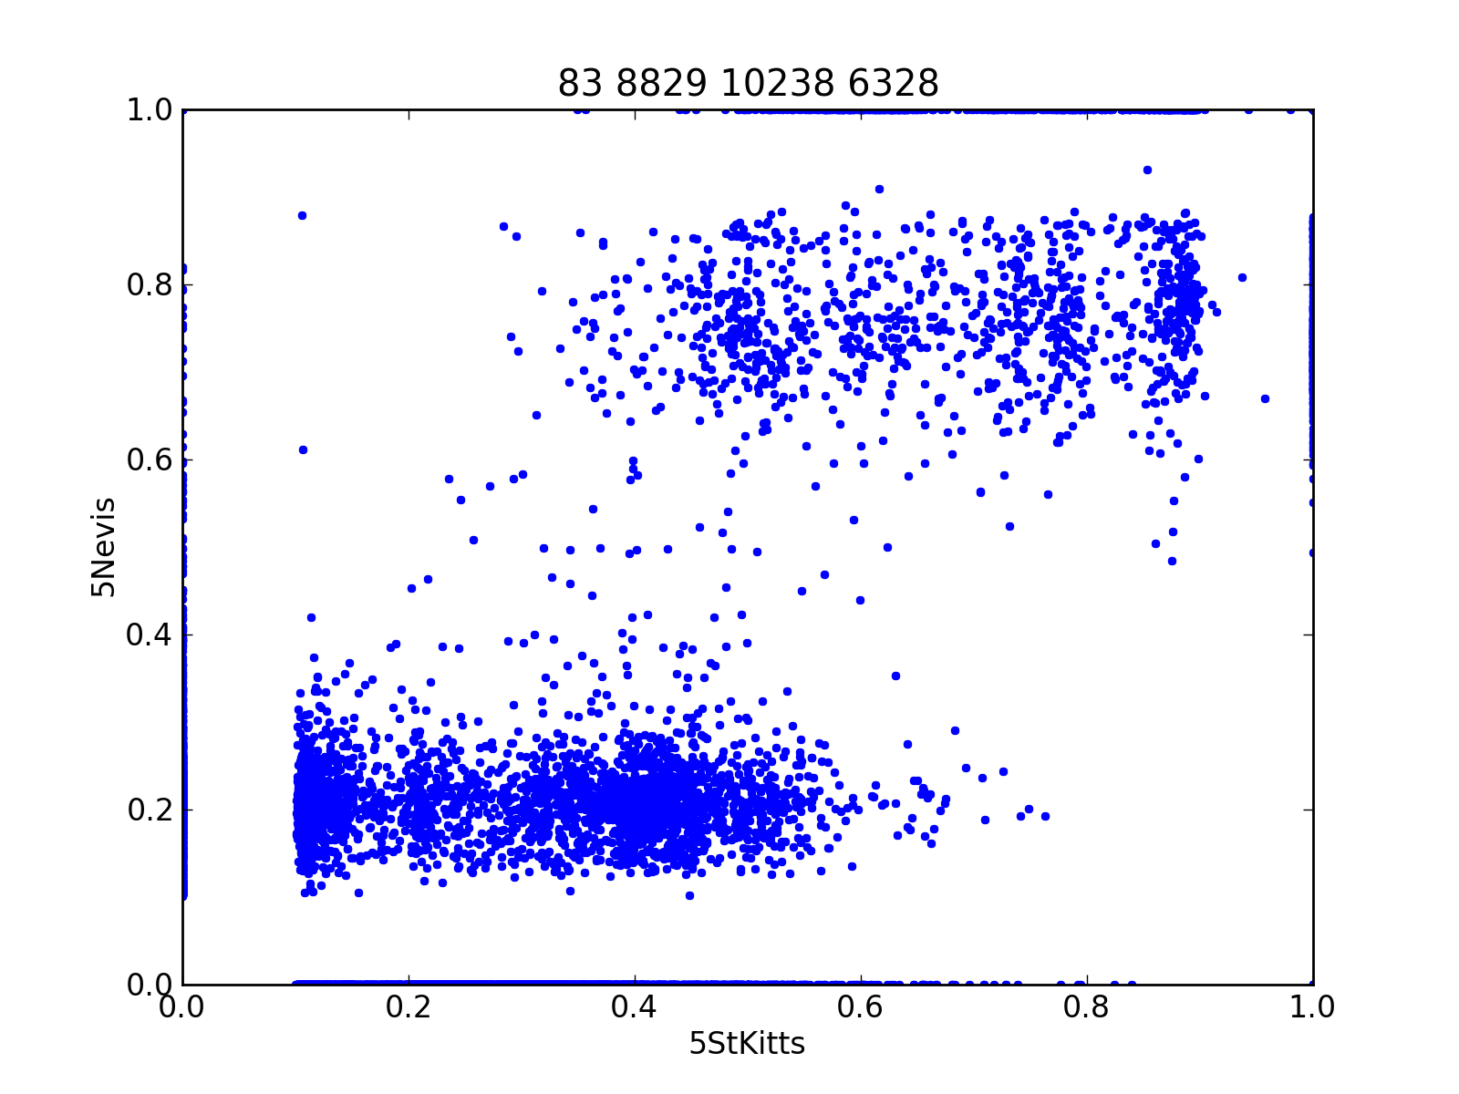
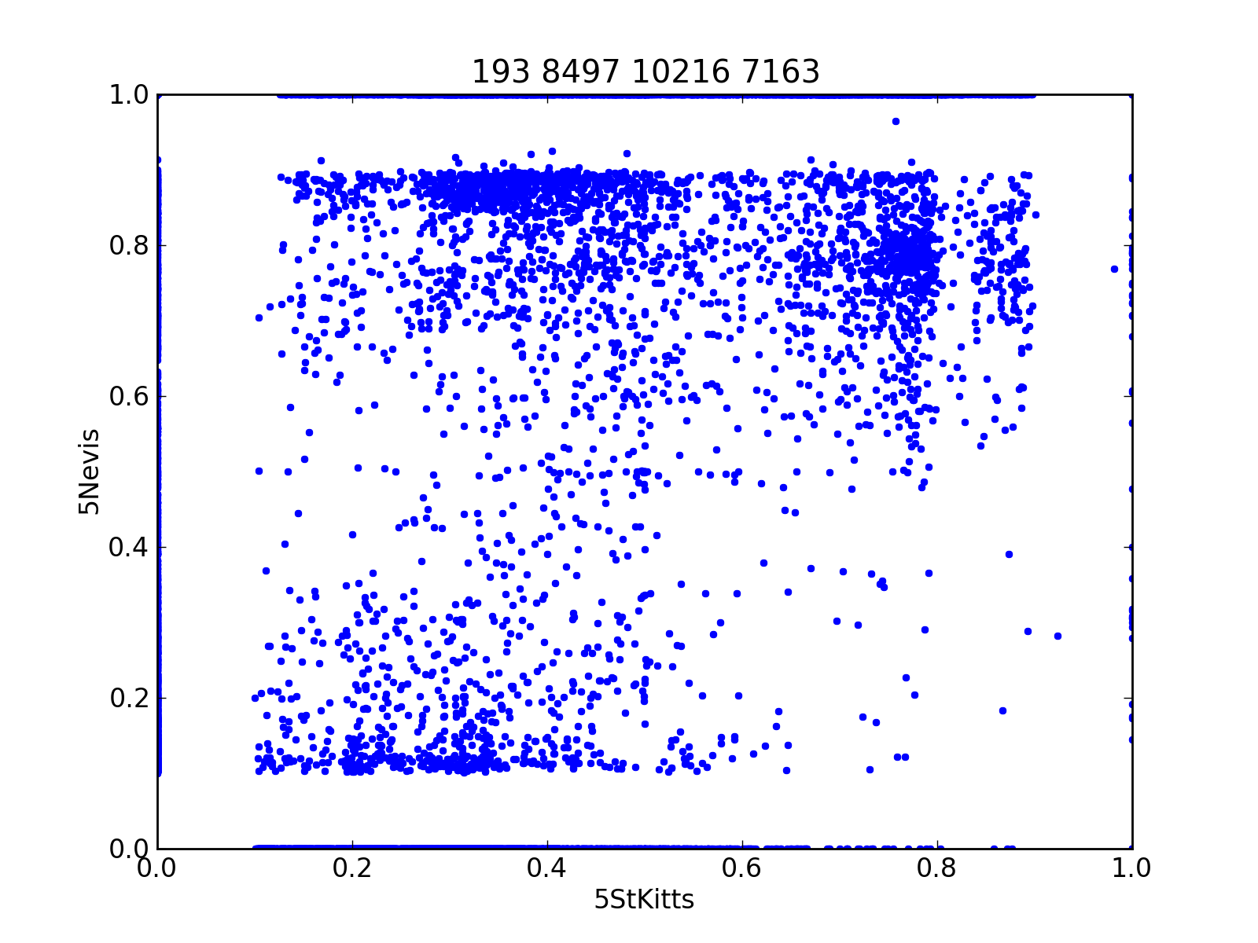
But some contigs look like:

Slide 34
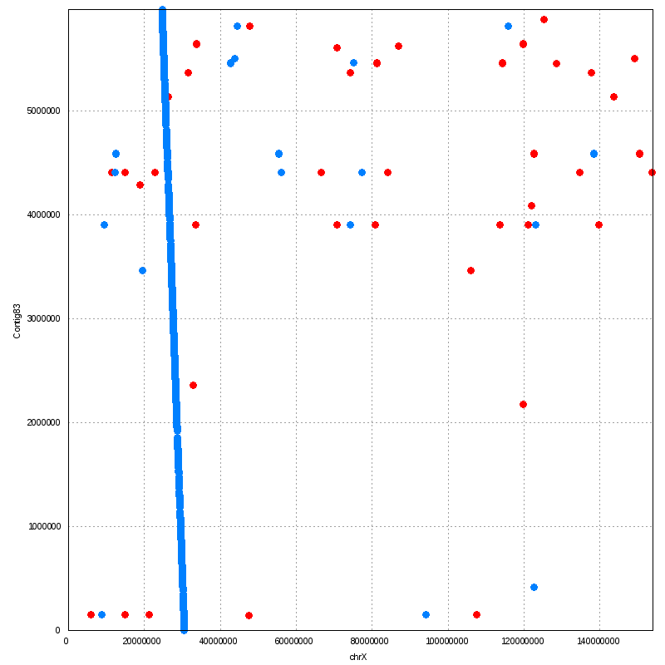
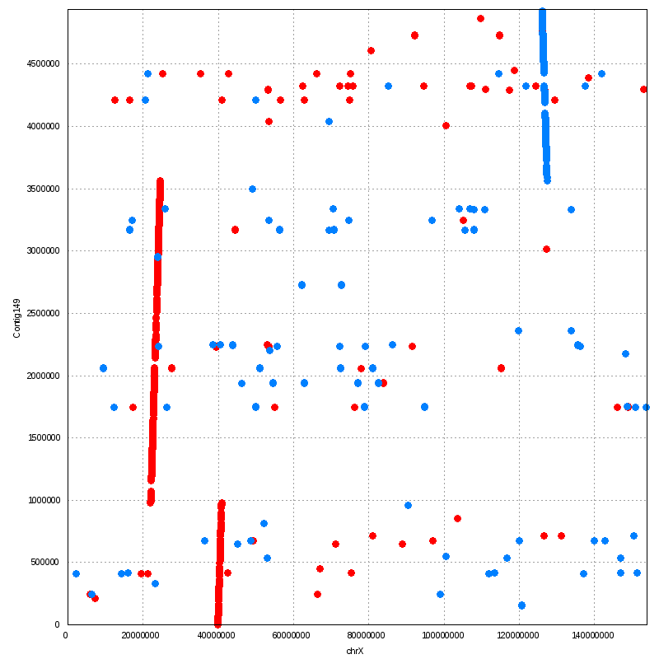
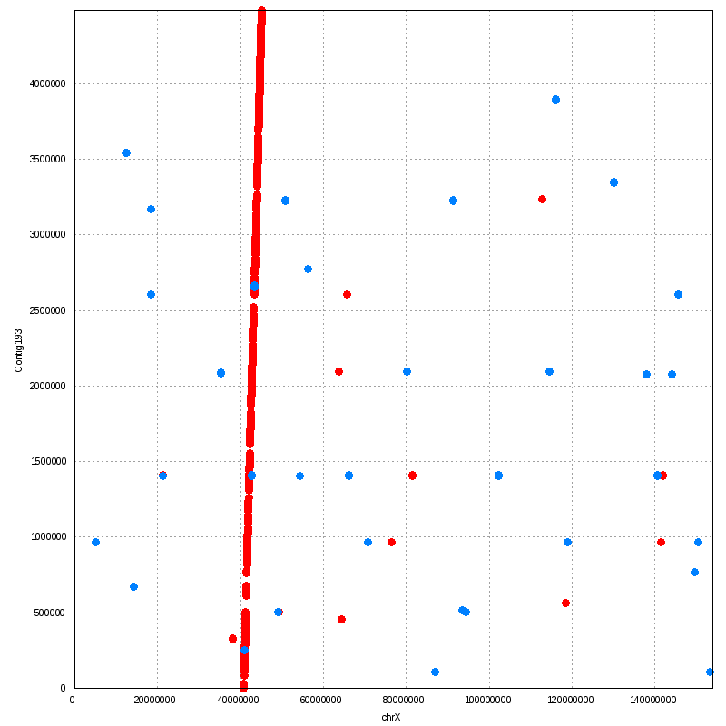
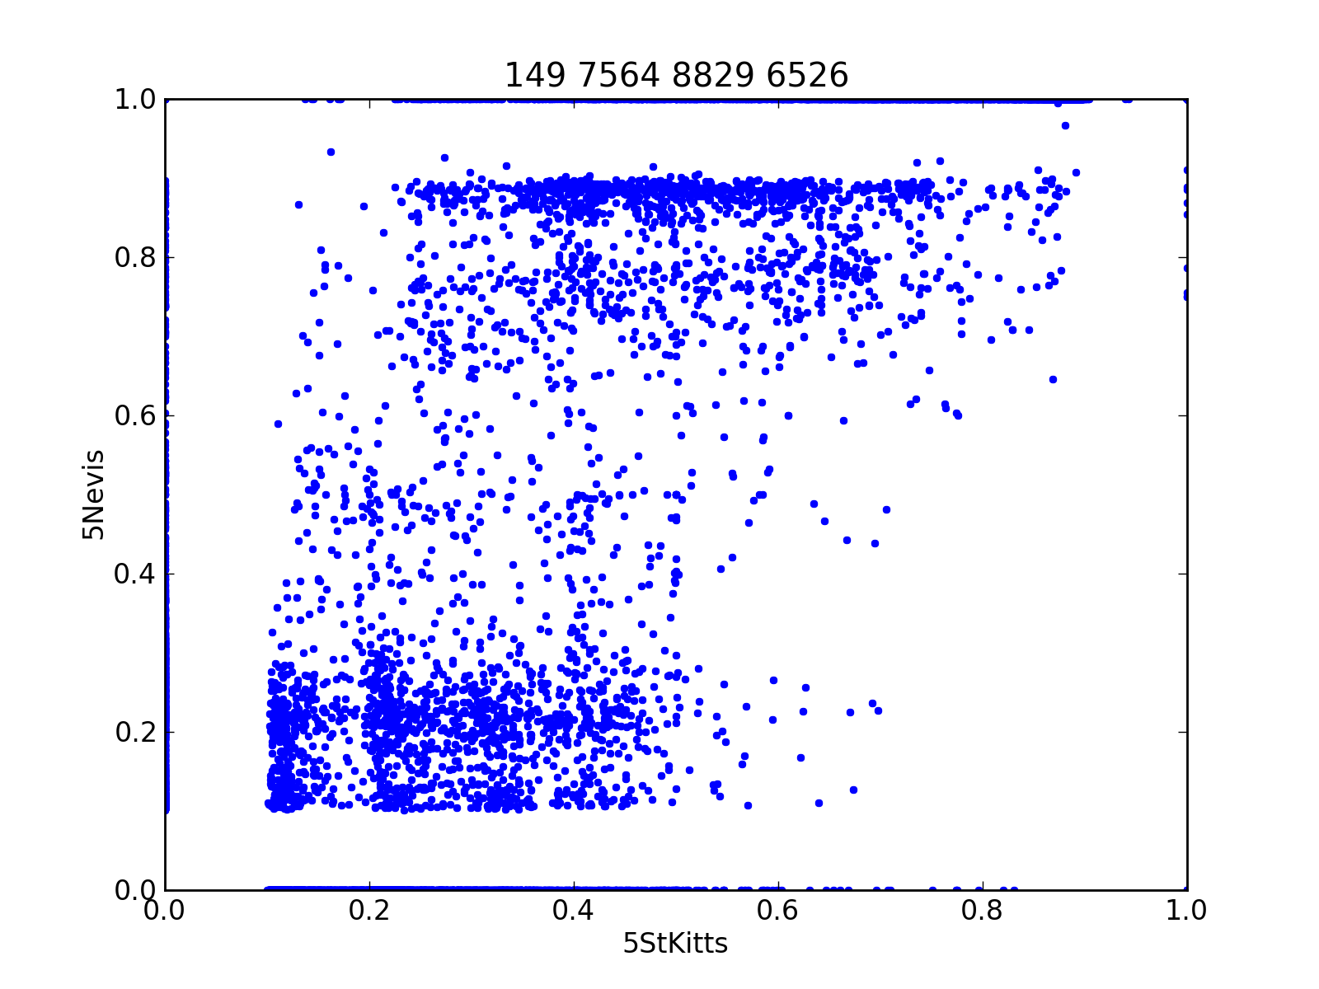
Focus on three of them that are mapped to macaque chr X.
Contig 83
Contig 149
Contig 193
Macaque ChrX
Their AAF plots all look like =>
=> Chr X in 5 Nevis monkeys
is of 2 haplotypes.

Slide 35
What are they suggesting?
St. Kitts and Nevis populations are separate and quite different from each other.
In some genomic regions, there is correlation of AAF, suggesting a common ancestry.
In some genomic regions, one population (5 monkeys in total though) is composed of 2 or 3 haplotypes, esp. the contigs on chr X.
All in all, data suggests the two populations have gone through a severe bottleneck in the past.

Slide 36
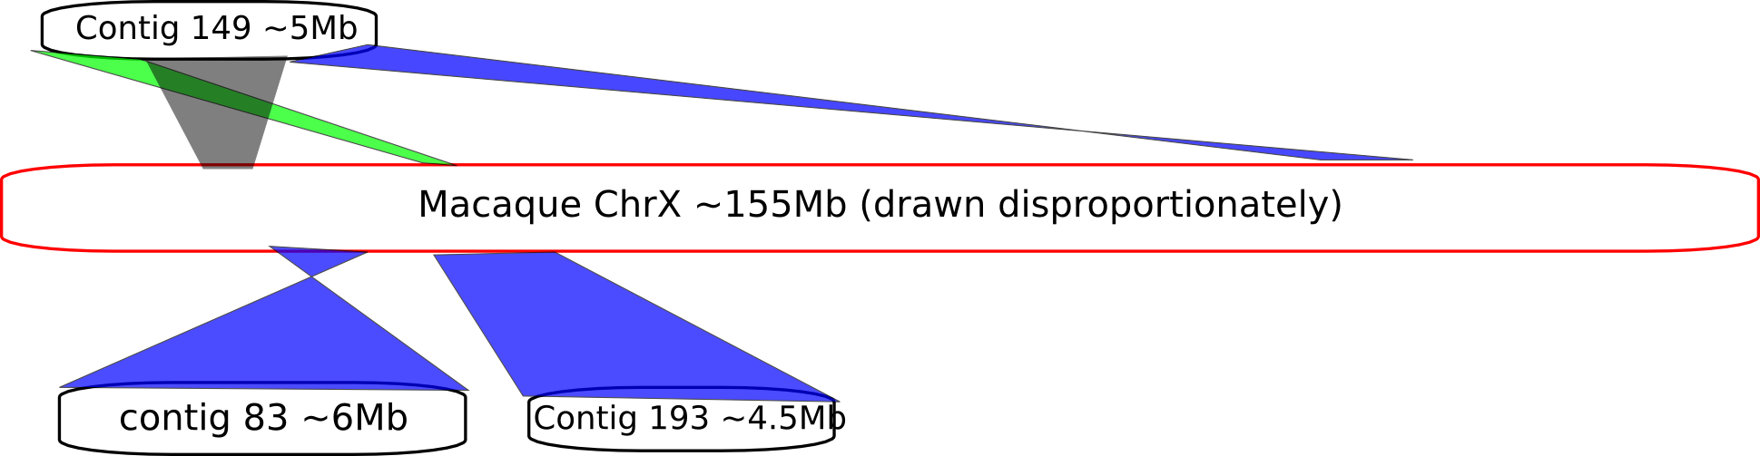
BTW, the three contigs that are all mapped to chr X suggest this structural event.
Duplication + inversion + translocation??

Slide 37
VRC v.s. St. Kitts & Nevis
Mating in VRC is by no means in HWE. We could not use all 116 sequenced VRC monkeys to estimate allele frequency because HWE is assumed in samtools.
So we picked 15 most-distant ones among the 116 sequenced to form a VRC sub-population.
We ran the variant-calling pipeline on this 15-distant-VRC population and compare the AAF (Alternative Allele Frequency) with 5 St. Kitts and Nevis monkeys.

Slide 38
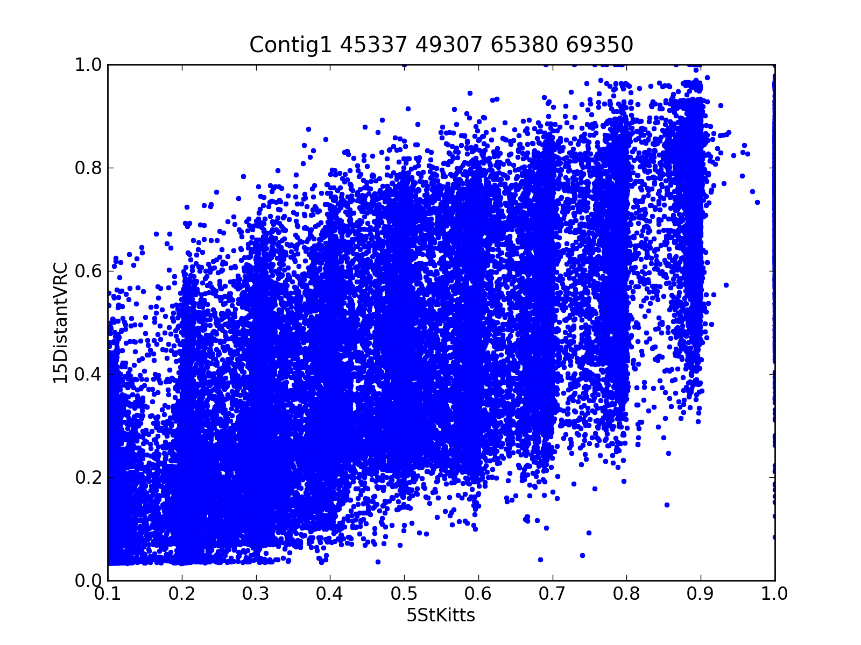
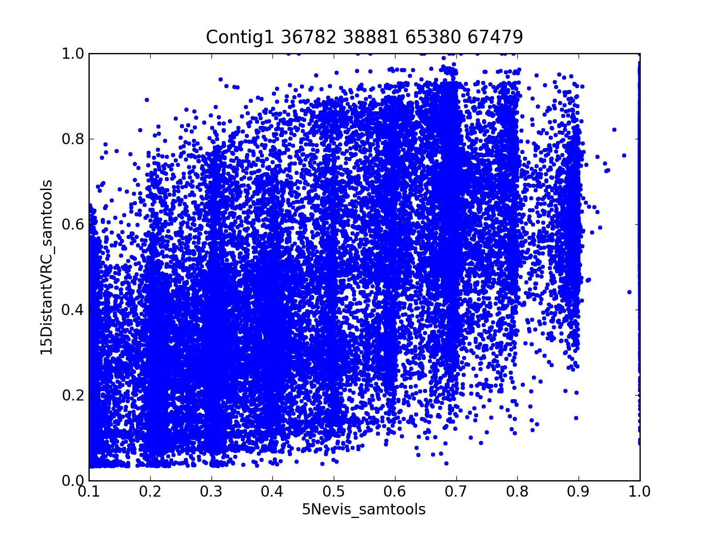
Most contigs look like Contig1:
15DistantVRC v.s. 5 Nevis
15DistantVRC v.s. 5 St. Kitts

Slide 39
How many variants that are unique to each population in this contig.
5,660 (12.1%) St. Kitts variants are not polymorphic in 15 distant VRC monkeys. 20,882 (33.8%) for variants from 15 distant VRC monkeys are not polymorphic in 5 St. Kitts monkeys.
4,172 (9.9%) Nevis variants are not polymorphic in 15 distant VRC monkeys. 23,971 (38.8%) for variants from 15 distant VRC monkeys are not polymorphic in 5 Nevis monkeys.

Slide 40
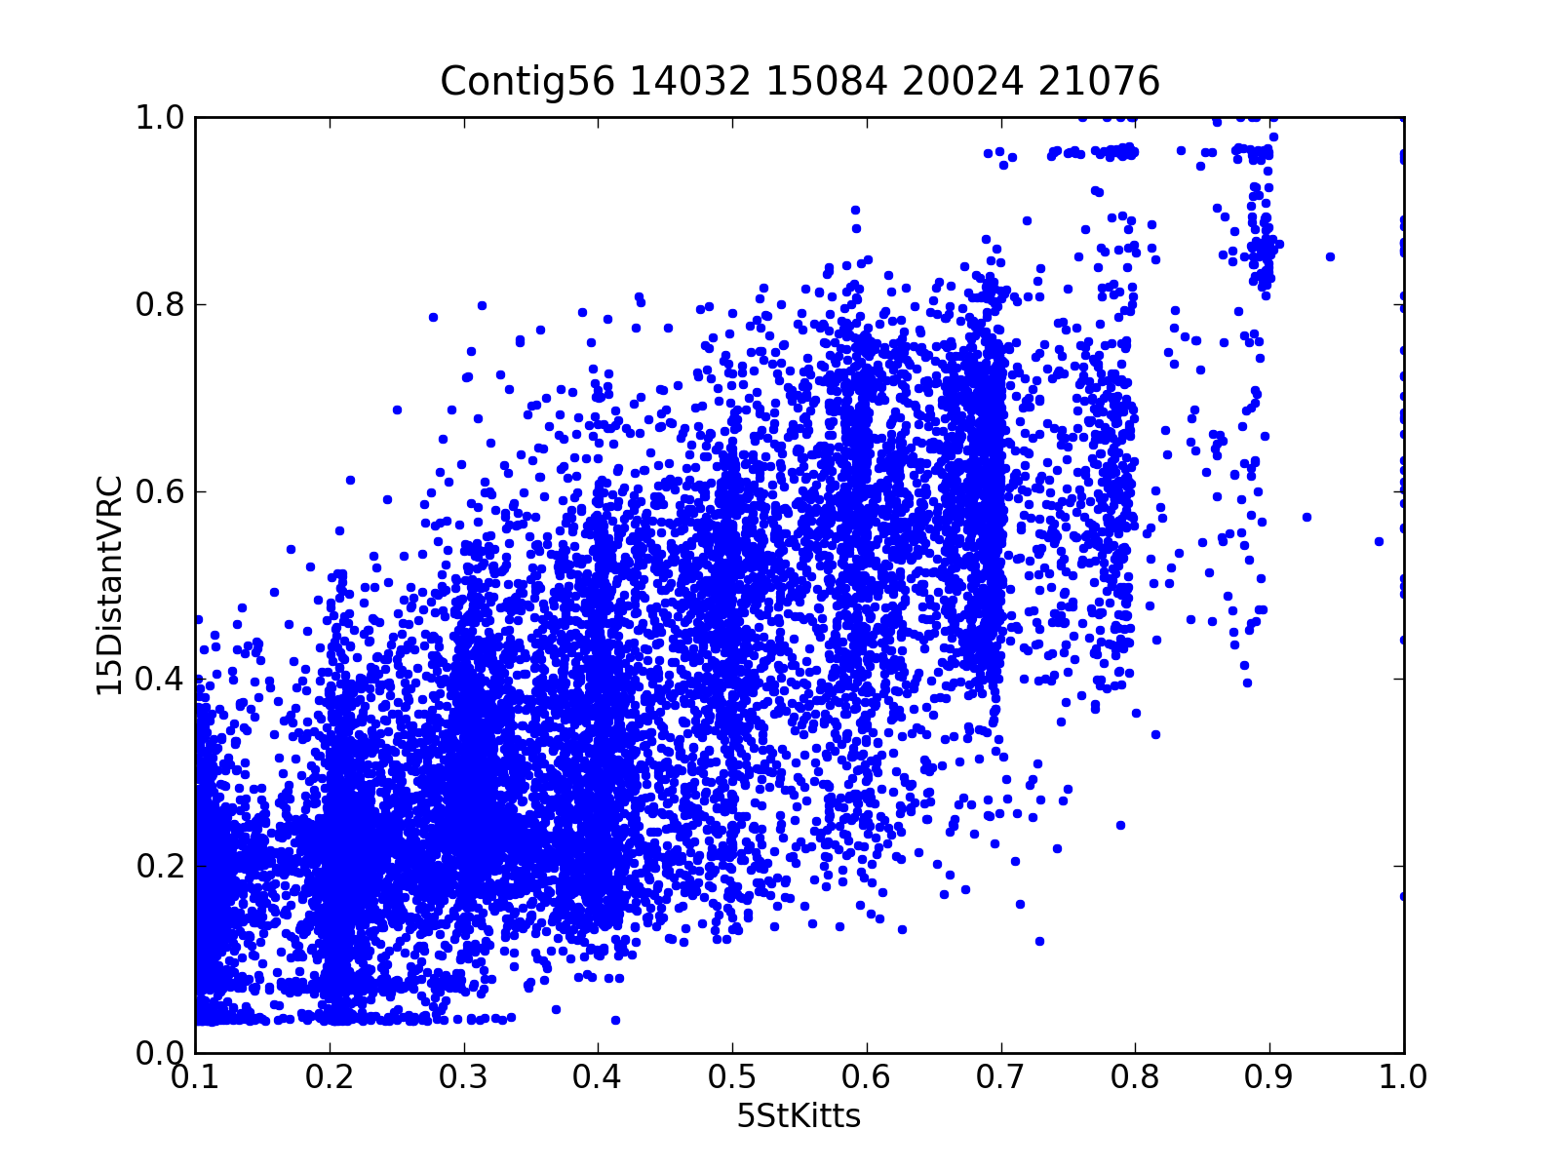
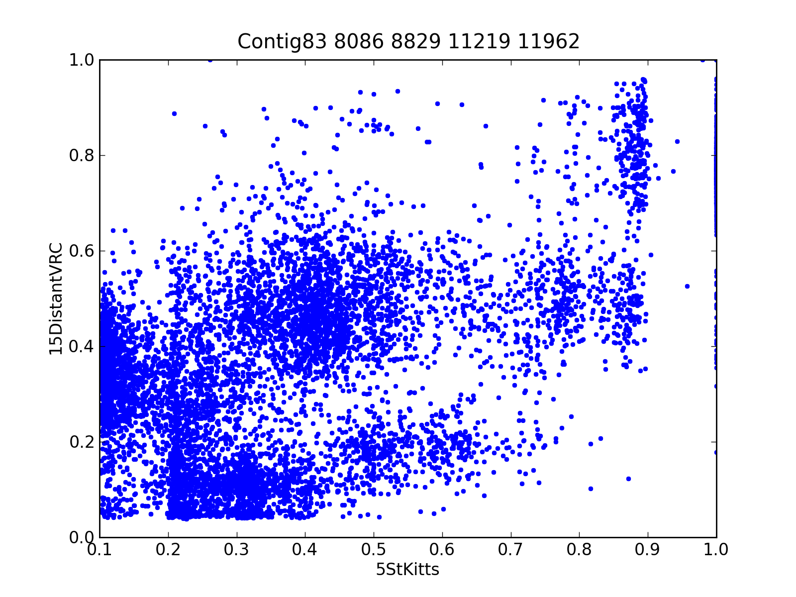
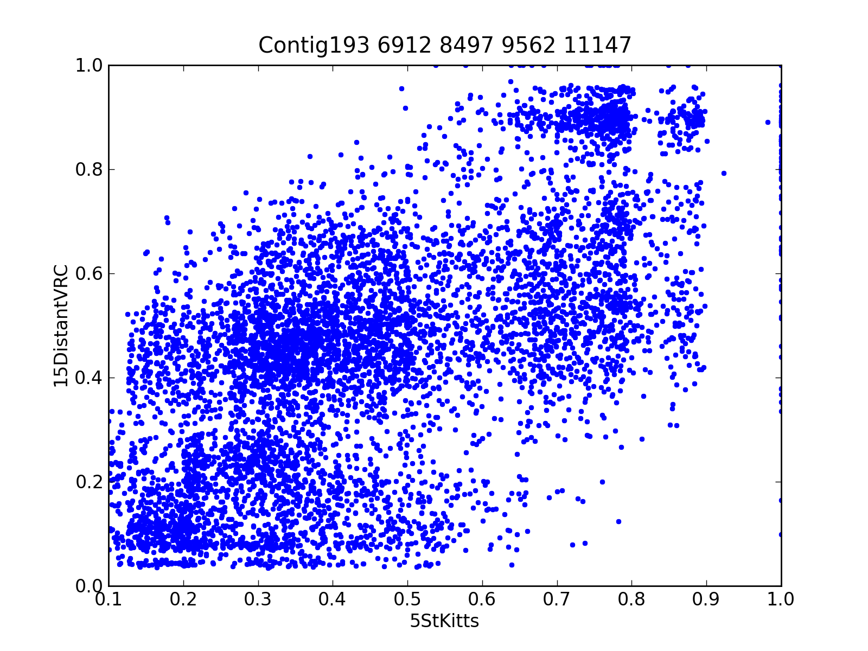
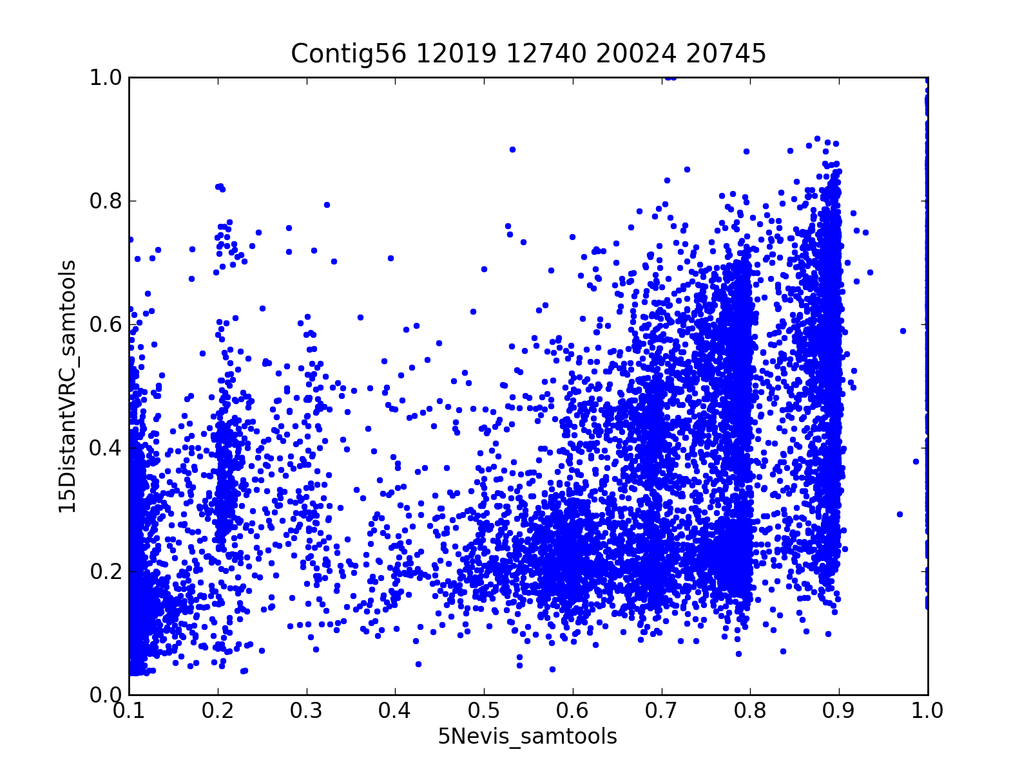
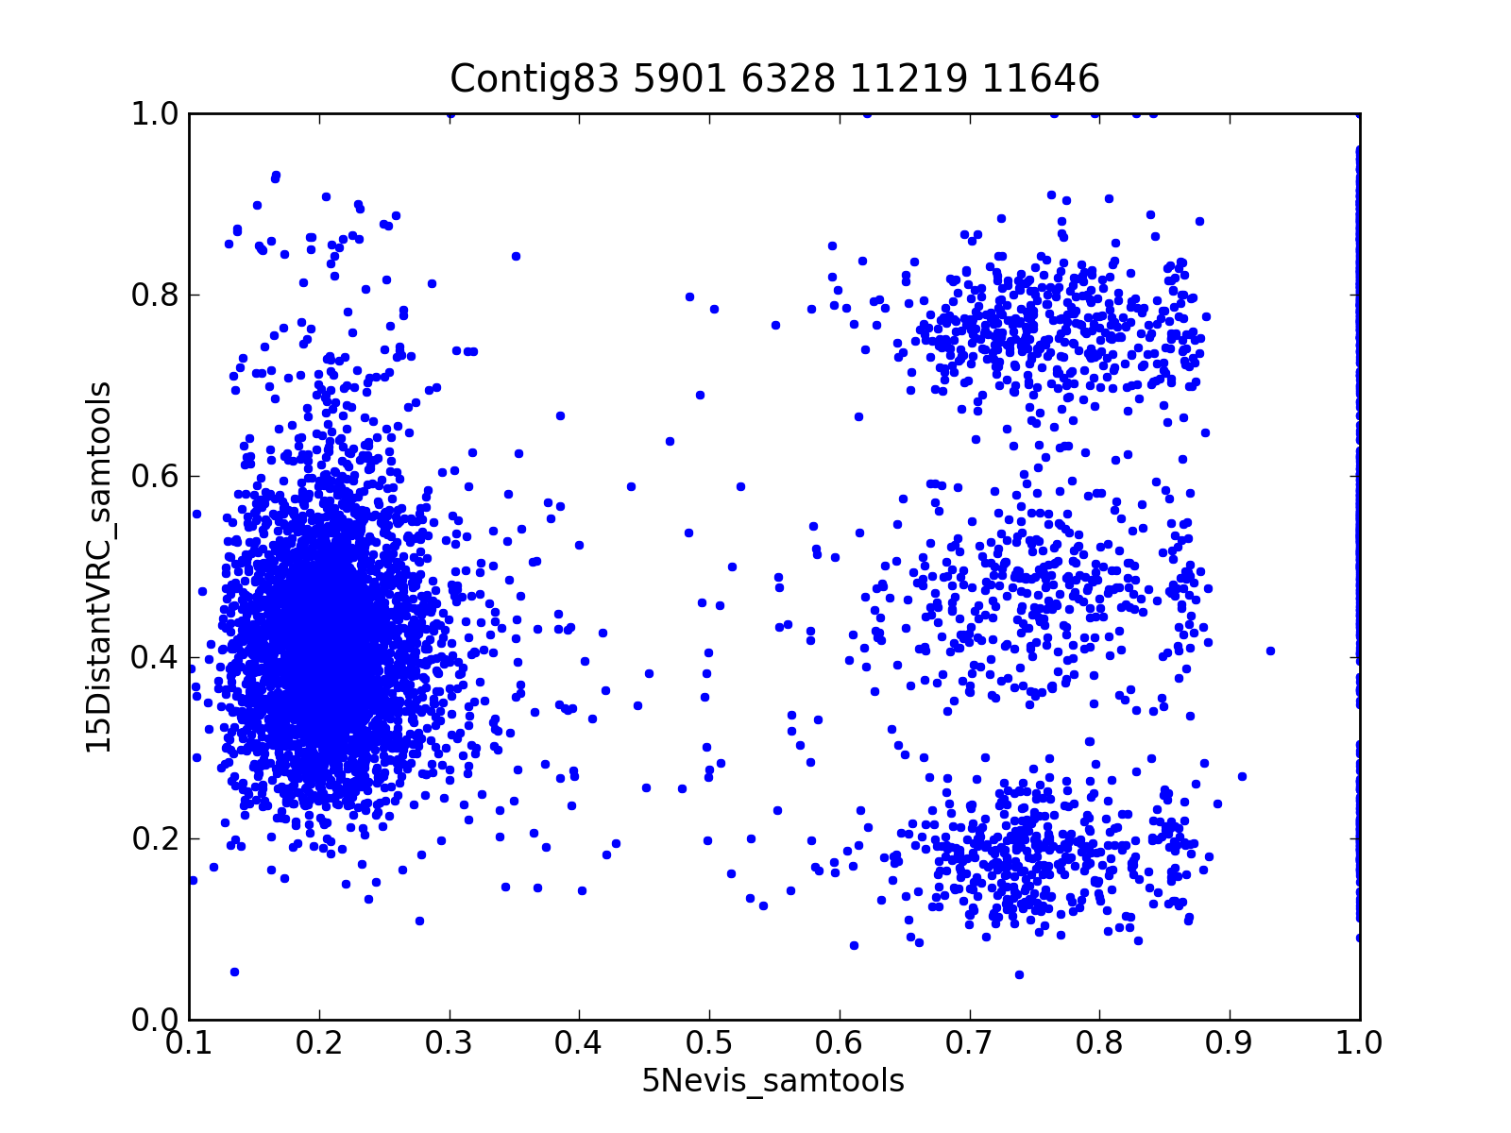
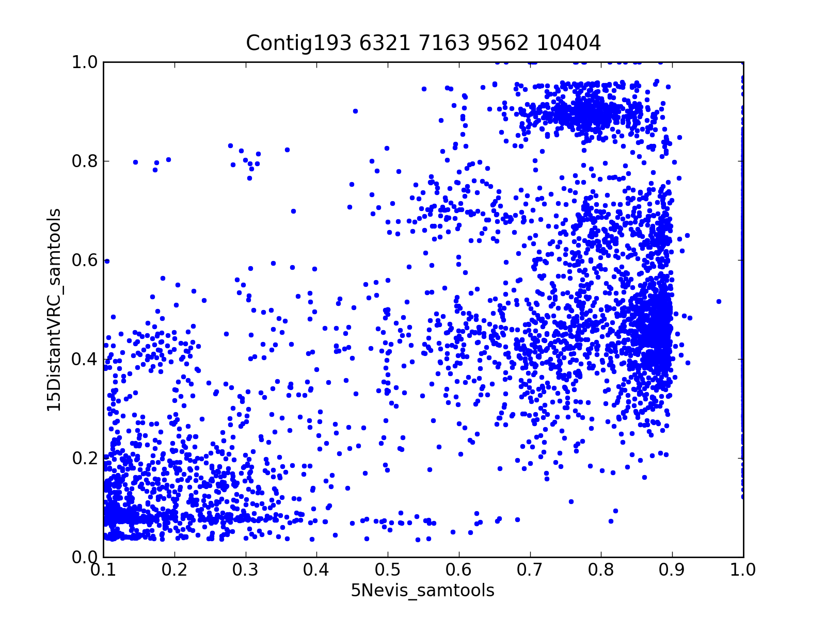
A couple of outliers:
15DistantVRC v.s. 5 St. Kitts
15DistantVRC v.s. 5 Nevis

Slide 41
VRC v.s. St. Kitts & Nevis
VRC has contribution from both St. Kitts and Nevis population.
Based on eyeballing AAF correlation, the contribution from St. Kitts is larger than that from Nevis.
There are regions (esp. chr X) that little correlation exists between VRC and St. Kitts/Nevis.

Slide 42
Outlook
Refine the pipeline
Filter based on depth, strand bias, etc.
Try ungapped alignment, which is good for avoiding highly-polymorphic regions.
Population genetic measures:
Nucleotide diversity
LD in different populations
Fst
Estimate ancestral population size and divergence time using human & macaque as outgroup.

Slide 43
Acknowledgement
Everyone in the room, etc.

